Slide 1


Slide 2

Just Flow – A menstrual cycle go to mobile application
Team Members: Mannila Sandhu (0682395),
Thrishma Reddy (0699028),
Yashi Gupta (0859432)
February 06, 2018

Slide 3
Introduction

Slide 4
Problem Statement
During menstrual cycle a woman under goes physical and mental stress due to hormonal changes like mood swings, cramps, cravings etc. They not only have to keep track of their periods but also deal with the following problems:
If you miss your periods, how do we keep track of them?
How to handle period cramps?
How to relieve stress?
What to do when in pain?
What is your mood and what to do in that mood?
Project Description
Just Flow is a mobile application for periods, designed keeping in mind the problems women face during that time. Studies show that periods is the time when women are most vulnerable to mood swings and other types of physiological and psychological instabilities due to the hormonal changes in their bodies. Therefore, this application will act as the much needed guide as well as a mood elevator for women in their periods.

Slide 5
What you did?
By comparing our project idea with other existing applications, we realized that the current applications do provide period tracking, but lack the knowledge base about medicines , exercises and stress-busters games.
Highlight of the research
Apart from adding the calendar feature available in the existing applications, we are also providing options to deal with the different moods while women are on their menstrual cycle.

Slide 6
Features

Slide 7
Periods Tracker
Medicines
FAQs
Food Suggestions - Food habits play a major role to ensure a smooth menstrual experience. This application will help the users to plan their meal routine during their periods. It will suggest what should be eaten and what should be avoided.
Exercises - Exercise affects a woman’s body hormone levels and can decrease those symptoms that we all dread every month. The suggested exercises are designed to stretch the abdominal muscles and can help relive the cramps.
De-stressing games - Last but not the least, there is a fun part incorporated in Just Flow. Users can play various games present on the application in order to distract themselves from the emotional imbalance and cramps.

Slide 8
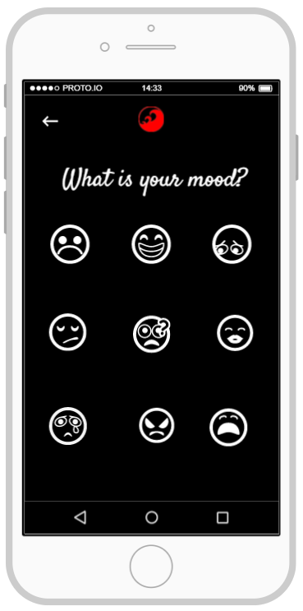
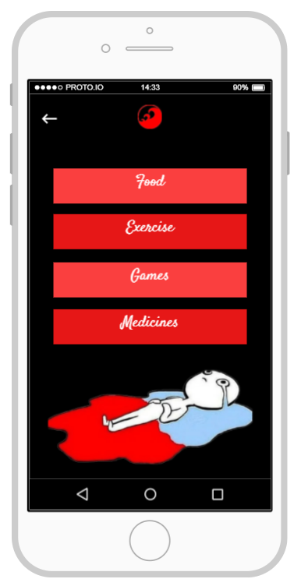
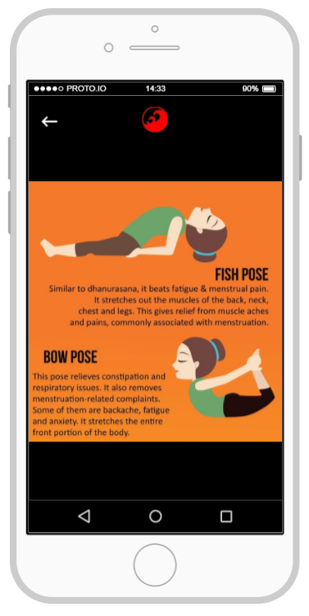

Slide 9
Development Tools

Slide 10
Prototype designing – proto.io
Application Development Tool – Android Studio
Programming Language used to develop application – Java
Game Development – libGDX (a java library for 2D game development)
Database Connectivity – JDBC
Operating System – Windows 10

Slide 11
User interface development https://share.proto.io/5IM4W8/

Slide 12
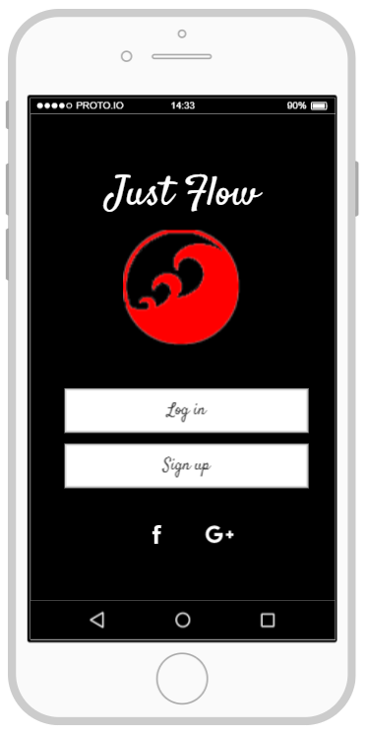
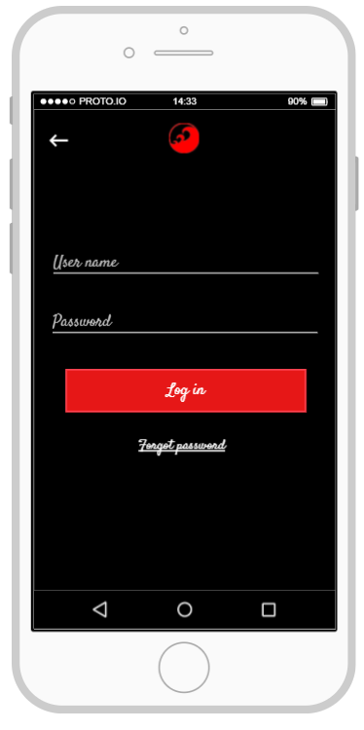
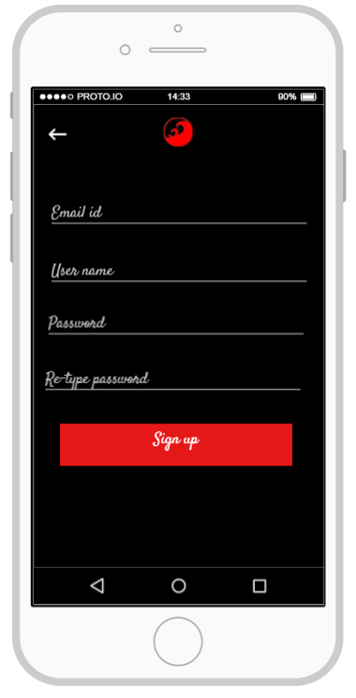

Slide 13
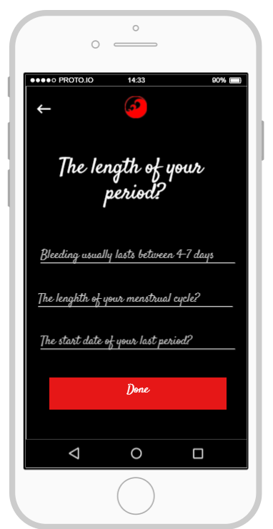
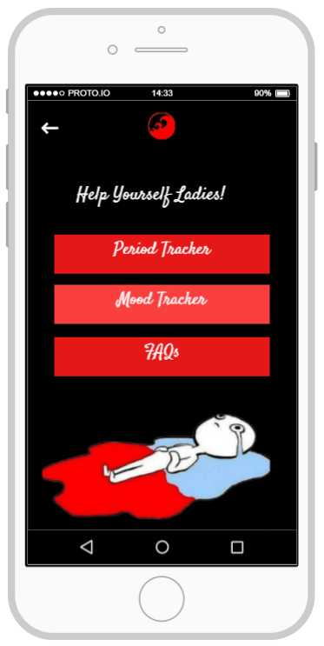
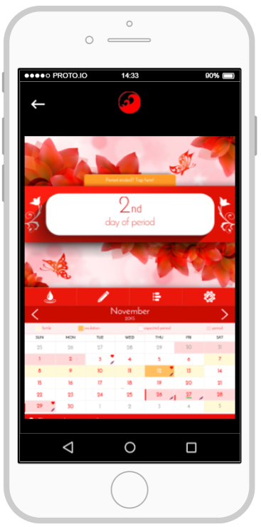

Slide 14
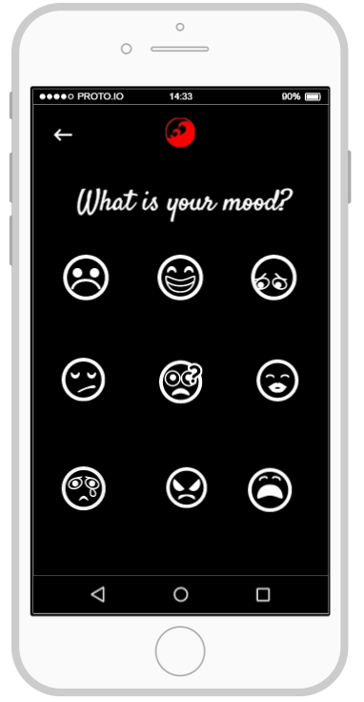
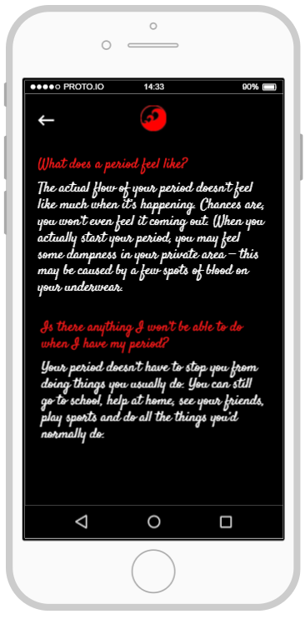
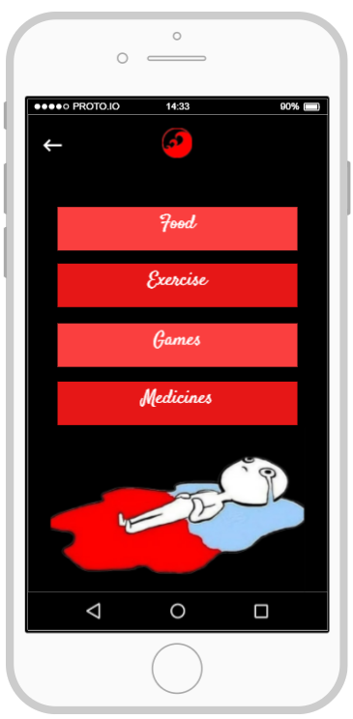

Slide 15
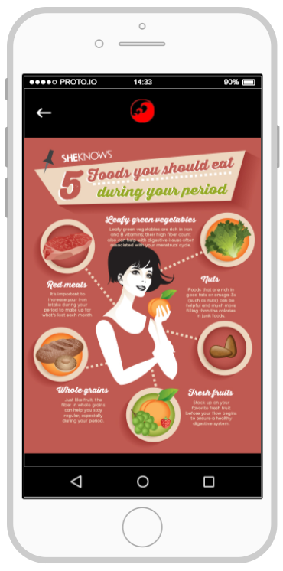
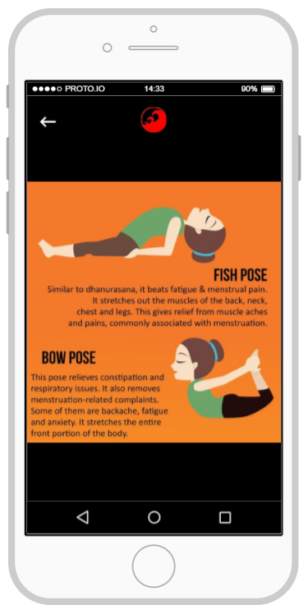
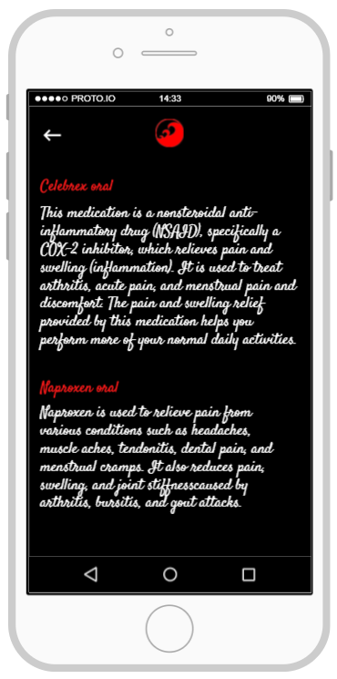

Slide 16
Discussion and Future Work

Slide 17
What’s the main insight?
We are creating the go to app for woman during their menstrual cycle.
2. Future work
We are finding sponsors to collaborate and launch the application on the Play store. Moreover, we will develop this application for iOS as well.
3. What are the shortcomings?
We cannot accurately predict the menstrual date because of the hormonal changes and there is no way to do so.

Slide 18
One Question From The Audience

